Slide 1


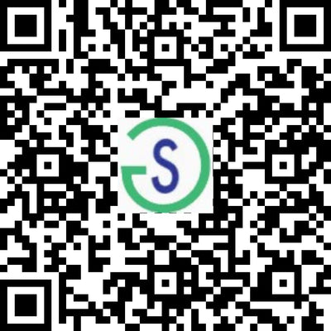
ACHIEVEMOR
Driven By Production, This is Innovation In Real-time!
ACCELERATE PURPOSE

Slide 2

Developing and delivering innovative solutions drives me. My long-term goals are set on providing opportunities that impact all minorities.
THE MARKETING STRATEGY
JARRETT RISHER
Founder & CEO, ACHIEVEMOR

Slide 3


Welcome to ACHIEVEMOR
We are an innovative consulting agency that is young and resourceful. We focus on achieving extraordinary results for our clients and how our work will affect others. Our ideal client is committed to success and the dedication needed to achieve it. They appreciate forward-thinking teams not selected from a box. If you are an entrepreneur or a longstanding organization, we are here to support your needs towards reaching your full potential.
WELCOME to ACHIEVEMOR.
AFFILIATE
SMARTLY

Slide 4




Our
approach
The more we learn about your business, the better we can help you achieve success and reach your desired results.
ED-TECH
Lead Generation
Software Development, eLearning, Blockchain

Slide 5






EDTECH
ACHIEVEMOR
The ACHIEVEMOR EDTECH framework includes the following:
Workforce Development
Recruitment, IT coding assessments for screening candidates, and curriculum development and student management for education, training, and in-house workshops.
Business Management
Business as a Service solutions for training centers, university systems, socioeconomic programs, onboarding programs for new-hires and tailor-made programs to fir your desired outcomes.
Experiential Learning
Innovative development for students or employees, preparing in batches, short, or long-term instruction, job-specific workshops for candidates you plan to hire. Take full control over the development and training with our engaging boot camps.

Slide 6

Career Readiness Preparatory Program
ACHIEVEMOR. 2022
6

Slide 7


Career Preparatory Program
We focus primarily on the skills gap among college graduates, or the difference between the skills students have developed at the point of graduation, compared to the skills employers expect that students have developed by the time they graduate and enter their career.
The question we need to ask is, what skills are important for students to develop to be considered, ready?
No one answer can be given to this question because different students have different career goals and learning styles.
LEARN 2 ACHIEVE MORE
Upskill Smartly

Slide 8
EDTECH
EFFECTIVE PERSONAL DEVELOPMENT
Type | Description | TM Forum Support | Benefits
70% Experiential | Learning from Experience On the job Business problem exercises Giving presentations | Collaboration programs Catalysts Hackathons | Understanding the needs of the market How to manage and work in ecosystems
20% Social | Social: learning from others Mentoring Networking Learning from peers and line Market research | Strategic workshops Coaching/mentoring Collaboration Inform-market analysis | Achieving common understanding Breaking down silos Keep up-to-date with market
10% Formal | Formal Learning | Online training Onsite workshops Career certification path | Establishing a common working language Understanding the challenges of the market Industry-recognised accreditation
A Proven Method
We feel that waiting to prepare the youth for a career is a thing of the past, rather start early and place them in real-life scenarios to better prepare them for the expectations and rigors of what goes into being successful and identifying career choices while in high school.
So, we are proposing to bring experiential learning workshops and bootcamps to underrepresented communities and start the preparation now, that they can be ready to close the skills gap before graduating high school.
We will provide experiential learning prep as an elective or stand-alone program at intervals over the span of a year, conduct an assessment at the six-month mark, and adjust or continue until program completion.
Our program will center around the following competencies:
Career & Self-Development
Leadership
Communication
Professionalism
Critical Thinking
Teamwork
Language
Technology
\

Slide 9

Employment Preparation
Resume writing tools to help with job preparation using emerging AI technology that increases efficiency and effectiveness for your CV and Resume to land more interviews.
ACHIEVEMOR. 2022
9

Slide 10




Industry Specific
eLearning Courses
Online Cyber
Security Classes
Online Diversity and Inclusion Classes
Online Entrepreneurship eLearning Classes

Slide 11

















Our PROVIDERS & AFFILIATES
WE ARE STILL GROWING Affiliate Smartly!

Slide 12
Additional Services
PROFESSIONAL
Recruiting
WEB DEVELOPMENT
WORKFORCE DEVELOPMENT
SaaS/ Opensource
Cyber Security
Mobile Apps
Freelancers & Virtual Assistants
Teachers & Trainers
OJT Instructors & Experts
Contact Us
Contact Us
Blockchain & WEB3
Career Planning
NFT, EDUCATION, CONSULTING
PERSONAL DEVELOPMENT
Intro to Blockchain
Certified Training
Development & Consulting
CV Writer and Job Search
Career Center & Internships
eLearning/Certified Training/ Career Development
Contact Us
Contact Us

Slide 13

Thank
Thank You
CONTACT US
434.207.6644 / 908.899.1099
training@achievemor.io
2055 LIMESTONE RD STE 200-C
Wilmington,DE 19808
www.achievemor.io
www.learn2achievemor.us

